Slide 1
MILESTONE PROJECT-1 EXCEL & SQL
NAME: SANJAIKUMAR S BATCH: FEB-2025 COURSE: DADS

Slide 2
INTRODUCTION
The "Salary Survey 2021" dataset contains 1,248 entries with
salary and employment details across Various industries,
including job titles, compensation, experience, education, and
demographics. It Provides insights into pay trends, disparities,
and regional differences for professionals worldwide.

Slide 3
DATA CLEANING
Remove Duplicates
Identified outliers
Spell checked
Standized city names
Grouping genders
Converted currency values

Slide 4
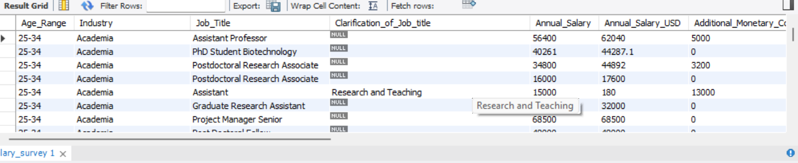
IMPORT TO SQL
Create Database
Create Table
Import data

Slide 5
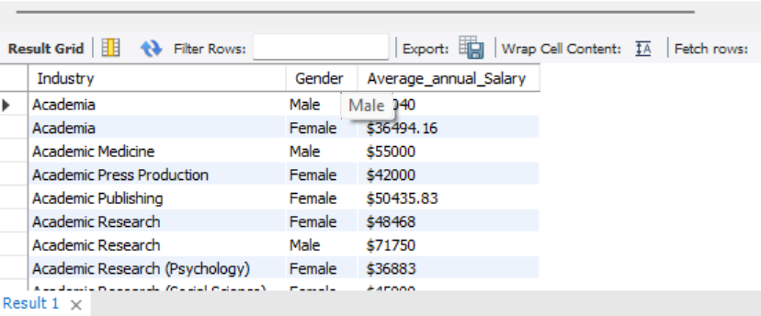
Average Salary by Industry and Gender
SELECT Industry,Gender,AVG(Annual_Salary) AS Avg_Salary FROM salary_data GROUP BY Industry,Gender ;

Slide 6
SELECT Job_Title,SUM(Annual_Salary + Additional_Monetary_Compensation) AS Total_Compensation FROM salary_data GROUP BY Job_Title ;
Total Salary Compensation by Job Title
Row Labels | Sum of sum(Additional_Monetary_Compensation_USD)
Partner | 2496300
Director Of Engineering | 2514000
Product Manager | 2811951.4
Managing Director | 2834500
Staff Software Engineer | 3394037
Engineering Manager | 3571738.1
Vice President | 3755256
Director | 4417487.02
Senior Software Engineer | 6012578.8
Software Engineer | 11549120.25
Grand Total | 43356968.57

Slide 7
GENDER WISE SALARY

Slide 8
INDUSTRY WISE COUNT

Slide 9
EXPERIENCED

Slide 10
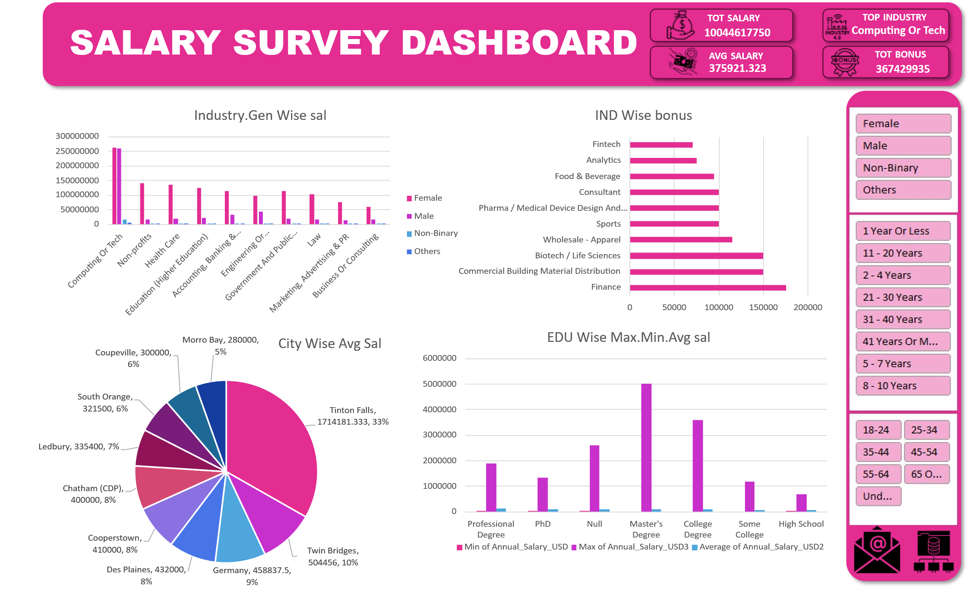
DASHBOARD

Slide 11
CONCLUSION
Higher education and mid-level experience (11–20 years) lead to the highest earnings. Advanced degrees significantly enhance salary potential.
Entry-level (≤1 year) and senior (31+ years) professionals contribute the least to salary totals, highlighting lower pay or fewer positions at career extremes.

Slide 12
THANK YOU

